Slide 1
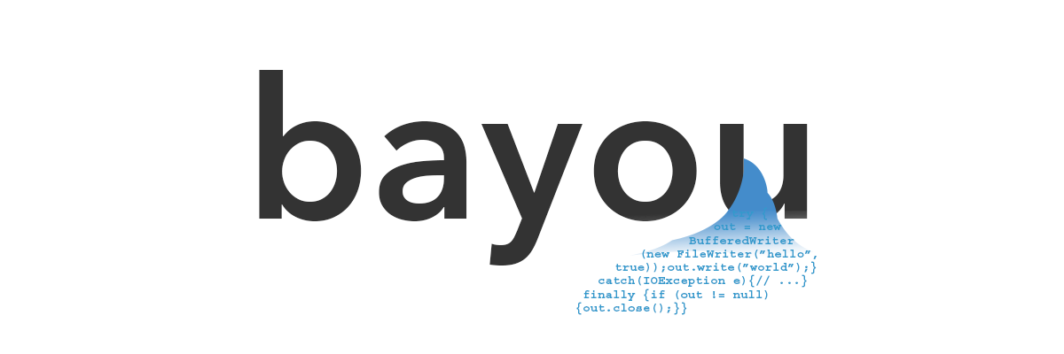

Deep Learning over “Big Code” for Program Analysis and Synthesis
Swarat Chaudhuri, Vijay Murali, Chris Jermaine

Slide 2
Programming is hard
Program synthesis, debugging, verification, repair…
Can we automate these processes?

Slide 3
Decades of prior work
Synthesis
[Pnueli & Rosner 1989]: temporal constraints
[Solar-Lezama 2008, Alur 2013]: partially written program (sketch)
[Gulwani 2011]: input-output examples
Debugging
[Weiser 1981, Korel-Laski 1988]: slicing criterion
[Ball-Rajamani 2002, Godefroid 2005]: model checking property
Most prior works require formal specifications!

Slide 4
Specifications
Practical tasks
Reading/writing an XML document
Displaying an Android dialog box
Connecting to an SQL server
… How to specify formally? …
Bayou: a statistical approach that lets us break out of the reliance on formal specifications
Built to handle “uncertain” specifications
Applicable to various problems in formal methods
In this tutorial: program synthesis, debugging (bug-finding)

Slide 5
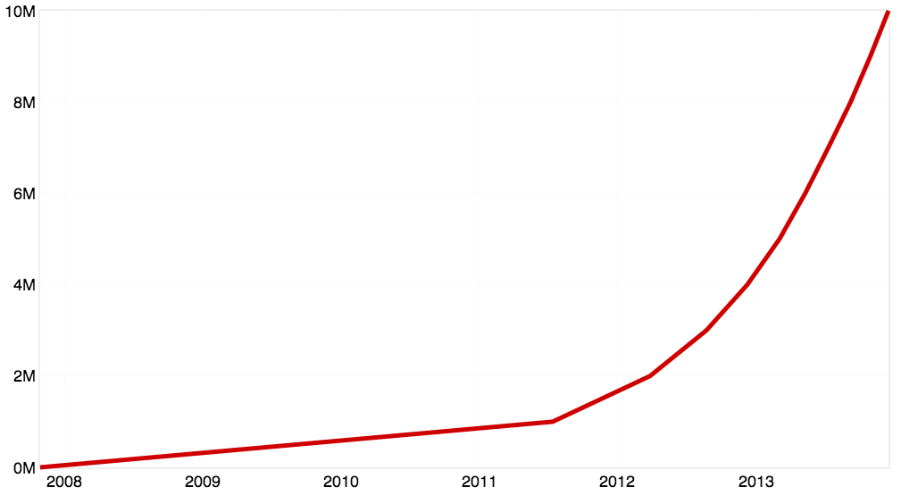
“Big Code”
Online code corpora offer great opportunities for specification learning
Especially useful for learning about broadly shared facets of programs
Advances in machine learning (ML) can be leveraged
“Deep learning”
But not enough by itself…
19.4 million active projects on GitHub (Oct. 2016)
Number of open-source projects on GitHub

Slide 6
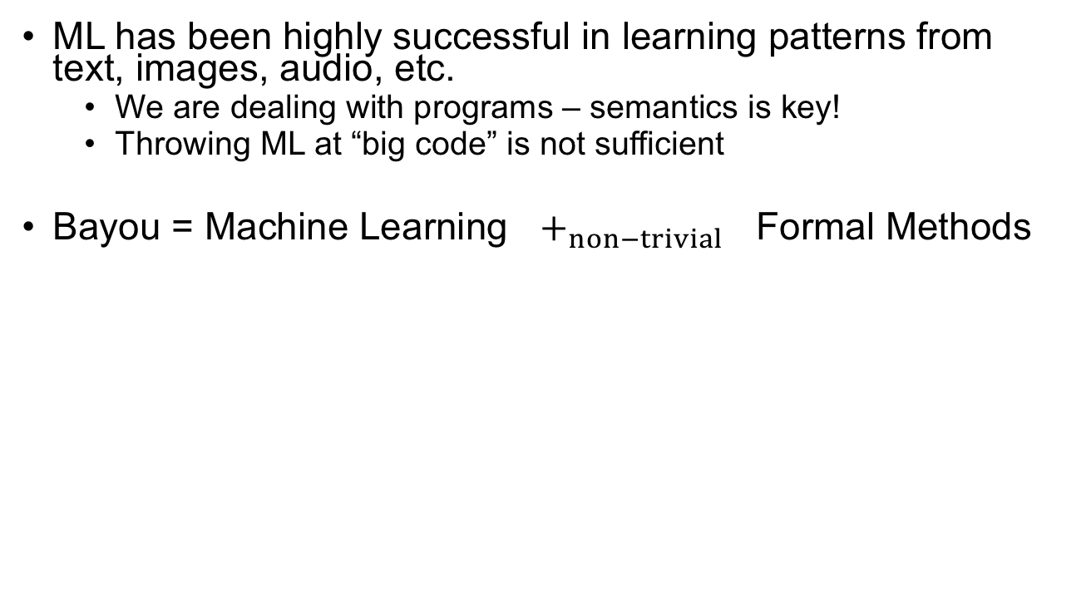
Synergy of ML & FM
ML has been highly successful in learning patterns from text, images, audio, etc.
We are dealing with programs – semantics is key!
Throwing ML at “big code” is not sufficient
Bayou = Machine Learning $+_{non−trivial}$ Formal Methods
Machine . Learning
Formal
Methods
Good at
handling
uncertainty
Good at
handling
semantics
Bayou

Slide 7
Related Work
“Big Code” is a very active area of research
[Raychev et al. 2014, Raychev et al. 2015]: data-driven code completion, analysis
[Gu et al. 2016]: predicting API sequences from natural language
[Yaghmazadeh et al. 2017]: SQL query synthesis
[Balog et al. 2017, Parisotto et al. 2017]: faster IO-example-based synthesis
How is Bayou different?
Generic probabilistic framework
Interaction with formal methods (e.g., sketch learning)
Real general-purpose programming language
Deep models

Slide 8
Outline
Introduction to the Bayou framework
BayouSynth
Underlying probabilistic model
BayouDebug
Implementing BayouSynth with deep neural networks
Feed-forward Neural Network
Recurrent Neural Network
The Encoder-Decoder architecture
Gaussian Encoder-Decoder
Type-directed synthesis
Implementing BayouDebug
Latent Dirichlet Allocation and Topic-Conditioned RNN
Conclusion

Slide 9
Outline
Introduction to the Bayou framework
BayouSynth
Underlying probabilistic model
BayouDebug
Implementing BayouSynth with deep neural networks
Feed-forward Neural Network
Recurrent Neural Network
The Encoder-Decoder architecture
Gaussian Encoder-Decoder
Type-directed synthesis
Implementing BayouDebug
Latent Dirichlet Allocation and Topic-Conditioned RNN
Conclusion

Slide 10
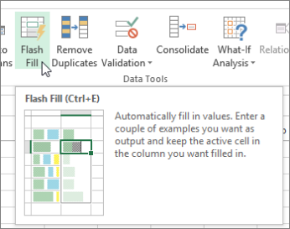
Program Synthesis
“Find a program that fits a specification.”
Many kinds of (formal) specifications: Input-output examples, traces, constraints, types…
Flash-fill (Microsoft Excel) can synthesize macros from a few examples [Gulwani 2011]
“One of the shock-and-awe features of Excel 2013.” — Ars Technica
Notes:
Heuristic compiler: Find programs

Slide 11
Program Synthesis
What about the typical programmer?
Read from a JSON/XML document
Connect to an Android Bluetooth socket
Query an SQL database
Displaying a dialog box in UI
…
BayouSynth
Java: works with a general purpose PL
APIs: synthesizes code involving APIs which are needed for most common tasks
Uncertainty: no need of a full formal specification

Slide 12
What do human programmers have that synthesizers don’t?

Slide 13
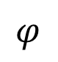
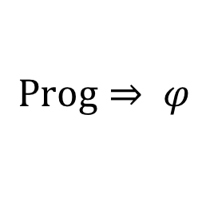
1. Ability to handle uncertainty
In formal methods and synthesis, specification is a Boolean property. A solution is valid iff it satisfies this property.
Formal specifications are too costly
Underspecifications can lead to meaningless output.
Humans can generalize imprecise and incomplete specifications.
Combinatorial Syntax-Guided Synthesizer
$$φ$$
$$\text{Prog}⇒ φ$$
Synthesizer
BufferedReader
new BufferedReader(…);

Slide 14
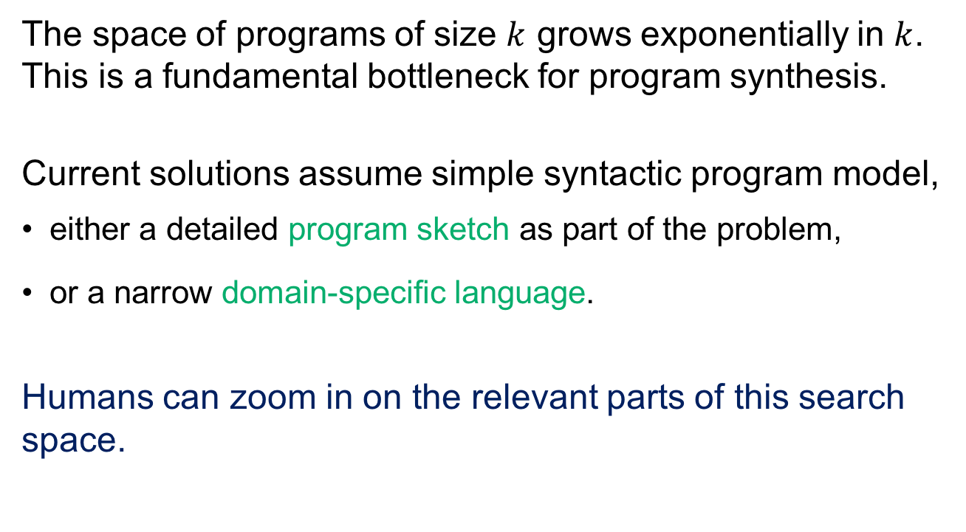
2. Much better search heuristics
The space of programs of size $k$ grows exponentially in $k$. This is a fundamental bottleneck for program synthesis.
Current solutions assume simple syntactic program model,
either a detailed program sketch as part of the problem,
or a narrow domain-specific language.
Humans can zoom in on the relevant parts of this search space.

Slide 15
Lesson from other areas of AI: Use data!
Notes:
Fundamental difference between AI of the 1970s and AI of the 2010s.
Gap between human abilities and machine’s abilities.

Slide 16

Human programmers use data
OK, so I need to open this text file, parse it, and…
Textbooks, documentation
Forums, chats
Other people’s code
Personal experience
Programmers use this data to build mental models of how to design programs.
This model lets them interpret programmer intent and “guess” the structure of solutions.

Slide 17
Probabilistic models let us mimic this process inside a synthesizer

Slide 18
Data-driven program synthesis
Prior distribution over syntax of programs and their associated evidence
An idealized program
Learned
from data
Evidence about what the program does
Synthesizer
Candidate implementations, based on posterior
Posterior distribution over program syntax

Slide 19
BayouSynth
Data-driven synthesis of API usage idioms
Web demo: www.askbayou.com
Source: github.com/capergroup/bayou
Neural Sketch Learning for Conditional Program Generation.
Vijayaraghavan Murali, Letao Qi, Swarat Chaudhuri, and Chris Jermaine.
International Conference on Learning Representations [ICLR] 2018
https://arxiv.org/abs/1703.05698

Slide 20
Outline
Introduction to the Bayou framework
BayouSynth
Underlying probabilistic model
BayouDebug
Implementing BayouSynth with deep neural networks
Feed-forward Neural Network
Recurrent Neural Network
The Encoder-Decoder architecture
Gaussian Encoder-Decoder
Type-directed synthesis
Implementing BayouDebug
Latent Dirichlet Allocation and Topic-Conditioned RNN
Conclusion

Slide 21

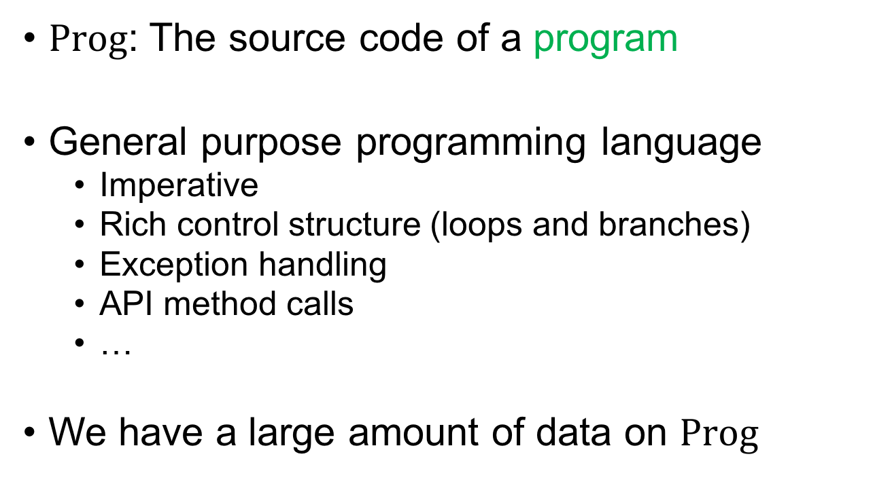
1. Programs
$$\text{Prog}$$
$\text{Prog}$: The source code of a program
General purpose programming language
Imperative
Rich control structure (loops and branches)
Exception handling
API method calls
…
We have a large amount of data on $Prog$

Slide 22

1. Programs
$$\text{Prog}$$
Language capturing essence of API usage in Java
API call
API method name

Slide 23
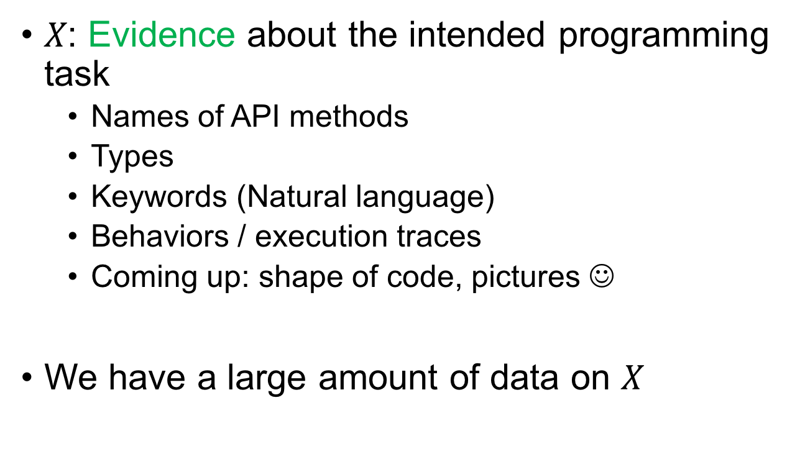
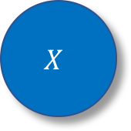
2. Evidence
$$X$$
$$\text{Prog}$$
𝑋: Evidence about the intended programming task
Names of API methods
Types
Keywords (Natural language)
Behaviors / execution traces
Coming up: shape of code, pictures ☺
We have a large amount of data on $X$

Slide 24
2. Evidence
$$X$$
$$\text{Prog}$$
API Calls: Set of the names of API methods called.
“readLine”, “close”
Types: Set of types on which API methods are called.
“FileReader”
Keywords: Textual description of programming task.
“read from file”, “print list”
Notes:
Sounds crazy, but says something important about APIs.

Slide 25
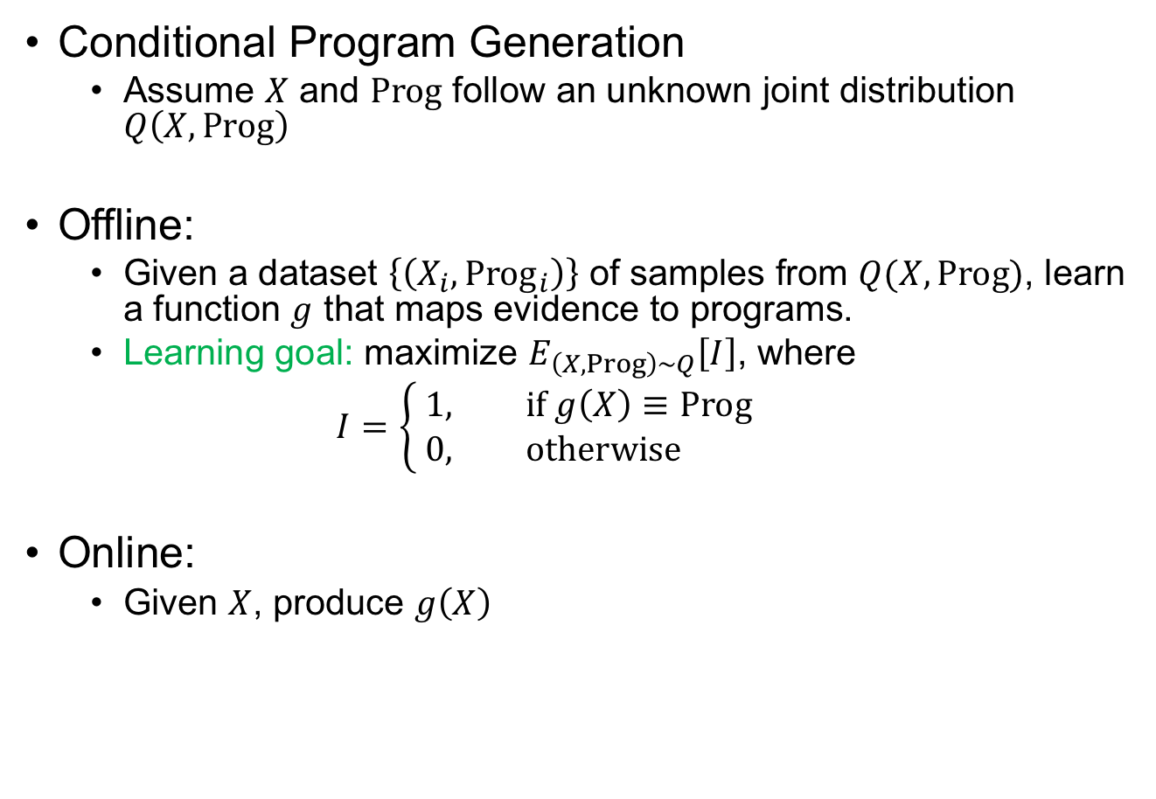
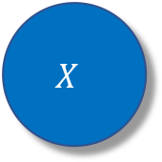
Problem Statement
$$X$$
$$\text{Prog}$$
Conditional Program Generation
Assume $X$ and $Prog$ follow an unknown joint distribution $Q\left(X, Prog\right)$
Offline:
Given a dataset $\left\{\left(X_{i}, Prog_{i}\right)\right\}$ of samples from $Q(X, Prog)$, learn a function $g$ that maps evidence to programs.
Learning goal: maximize $E_{\left(X, Prog\right)∼Q}\left[I\right]$, where
$$I=\left\{\begin{aligned} &1, \text{if} g\left(X\right)≡Prog \\ &0, \text{o}\text{therwise}\end{aligned}\right.$$
Online:
Given $X$, produce $g\left(X\right)$

Slide 26
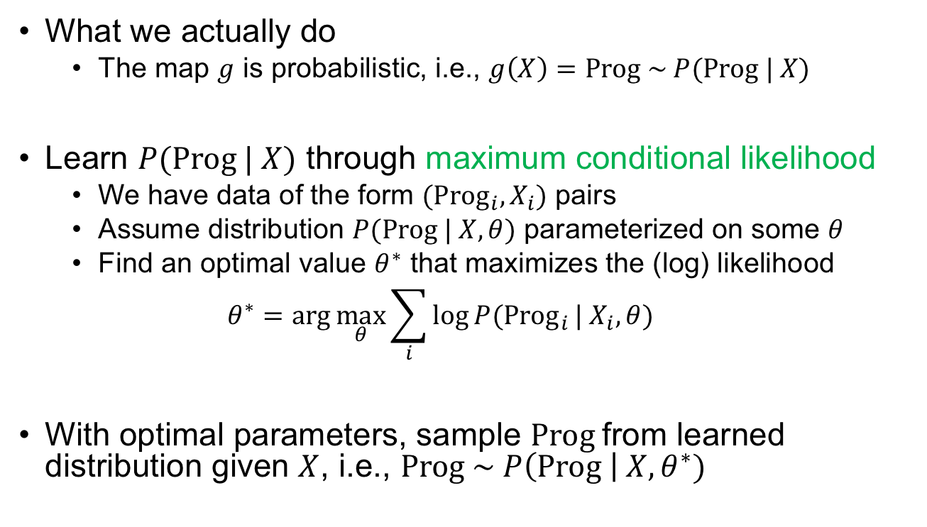
Problem Statement
$$X$$
$$\text{Prog}$$
What we actually do
The map $g$ is probabilistic, i.e., $g\left(X\right)=Prog \sim P(\text{Prog} | X)$
Learn $P(\text{Prog} | X)$ through maximum conditional likelihood
We have data of the form $(\text{Pro}{\text{g}}_{i}, X_{i})$ pairs
Assume distribution $P(\text{Prog} | X, θ)$ parameterized on some $θ$
Find an optimal value $θ^{∗}$ that maximizes the (log) likelihood
$$θ^{∗}=\arg{\max_{θ}{\sum_{i}{\log{P(\text{Pro}{\text{g}}_{i}}| X_{i}, θ)}}}$$
With optimal parameters, sample $\text{Prog}$from learned distribution given $X$, i.e., $\text{Prog} \sim P\left(\text{Prog} \right| X, θ^{∗})$

Slide 27
Challenge in Big Code setting
void read() throws IOException {
FileReader in = new
FileReader(“a.txt”);
BufferedReader br = new
BufferedReader(in);
String line;
while ((line=br.readLine())!=null)
{
System.out.println(line);
}
br.close();
}
int read(String name) {
FileReader fr; BufferedReader r;
String s; int n = 0;
try {
fr = new FileReader(name);
r = new BufferedReader(fr);
for (; (s=r.readLine()) != null;
n++);
r.close();
return n;
} catch (IOException e) { return -1; }
}
Both programs perform the task “reading from a file”

Slide 28
Data inherently contains noise
From superficial differences irrelevant for synthesis
Variable names
Intermediate expressions
Syntactic forms (for loop vs. while loop)
Superficial differences in programs make it hard for probabilistic model to learn patterns
From knowledge already known
Type safety constraints
Language-level rules (e.g., exceptions must be caught)
Probabilistic model learned from data cannot guarantee type safety constraints and rules

Slide 29
Key insight…
Probabilistic models are adept at learning unknown patterns from data
Synthesizers are adept at handling known semantic and syntactic constraints
Learn to generate programs at a higher level of abstraction and use combinatorial synthesizer to produce final code

Slide 30
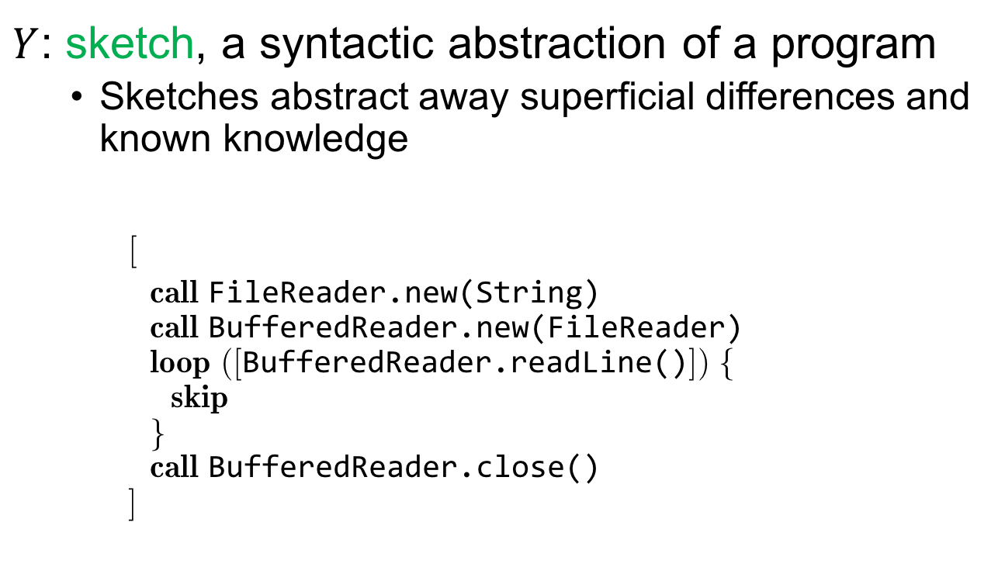
3. Sketches
$$X$$
$$Prog$$
$Y$: sketch, a syntactic abstraction of a program
Sketches abstract away superficial differences and known knowledge
[
call FileReader.new(String) call BufferedReader.new(FileReader) loop ([BufferedReader.readLine()]) { skip } call BufferedReader.close() ]

Slide 31
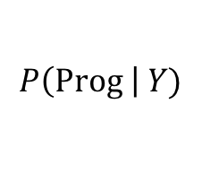
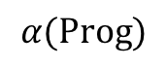
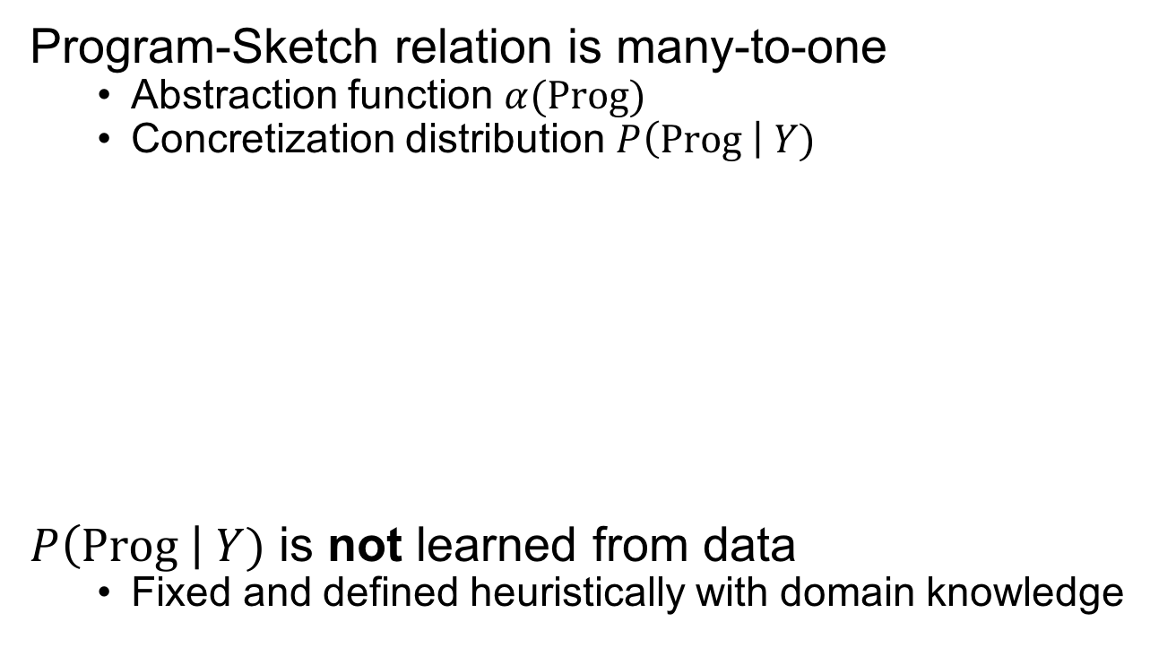


3. Sketches
$$X$$
$$Prog$$
Program-Sketch relation is many-to-one
Abstraction function $α(Prog)$
Concretization distribution $P\left(Prog \right| Y)$
$P\left(Prog \right| Y)$ is not learned from data
Fixed and defined heuristically with domain knowledge
$$α(Prog)$$
$$Prog$$
$$Y$$
$$P\left(Prog \right| Y)$$

Slide 32
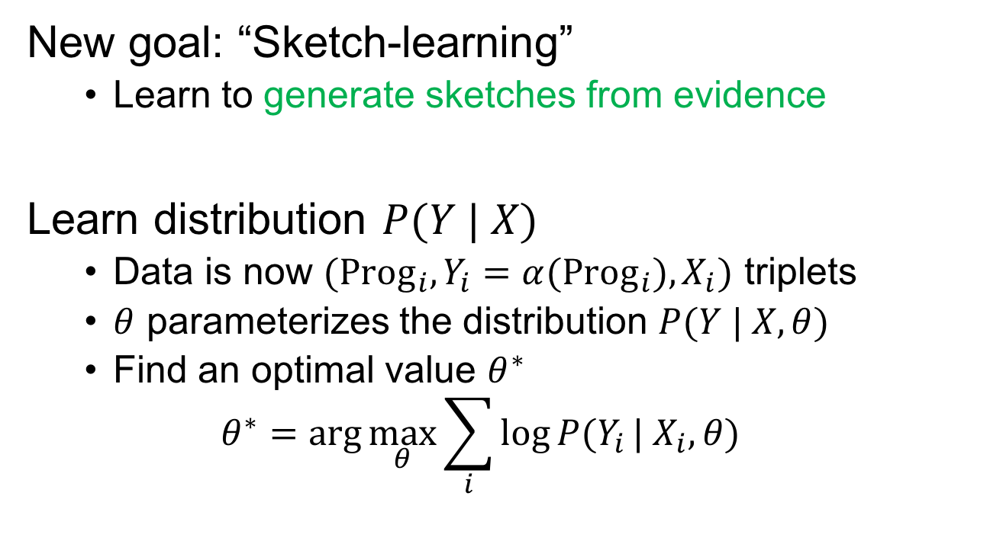

3. Sketches
$$X$$
$$Y$$
$$Prog$$
New goal: “Sketch-learning”
Learn to generate sketches from evidence
Learn distribution $P(Y | X)$
Data is now $({Prog_{i},Y}_{i}=α(Prog_{i}), X_{i})$ triplets
$θ$ parameterizes the distribution $P(Y | X, θ)$
Find an optimal value $θ^{∗}$
$$θ^{∗}=\arg{\max_{θ}{\sum_{i}{\log{P(Y_{i}}| X_{i}, θ)}}}$$

Slide 33
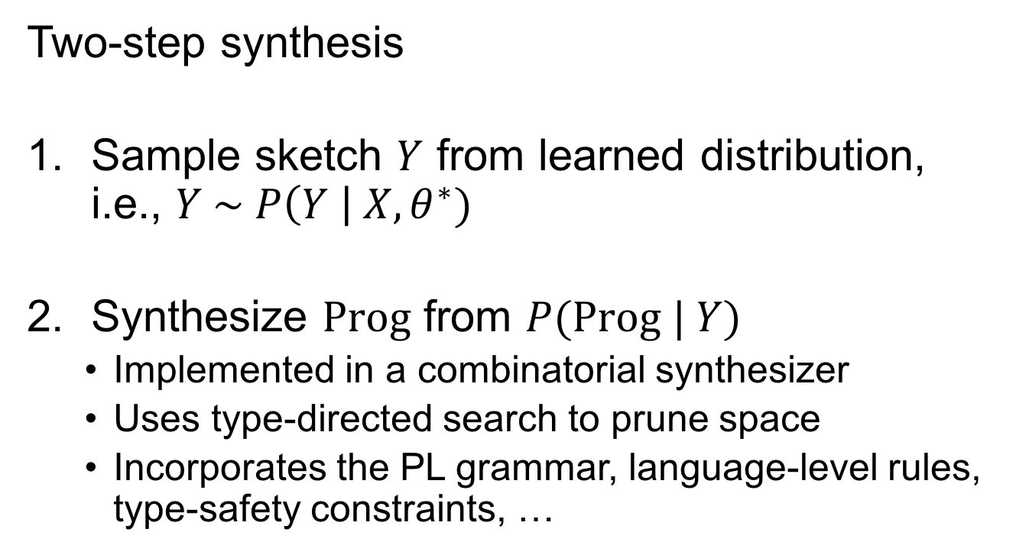
3. Sketches
$$X$$
$$Y$$
$$Prog$$
Two-step synthesis
Sample sketch $Y$ from learned distribution, i.e., $Y \sim P\left(Y \right| X, θ^{∗})$
Synthesize $Prog$ from $P(Prog | Y)$
Implemented in a combinatorial synthesizer
Uses type-directed search to prune space
Incorporates the PL grammar, language-level rules, type-safety constraints, …

Slide 34
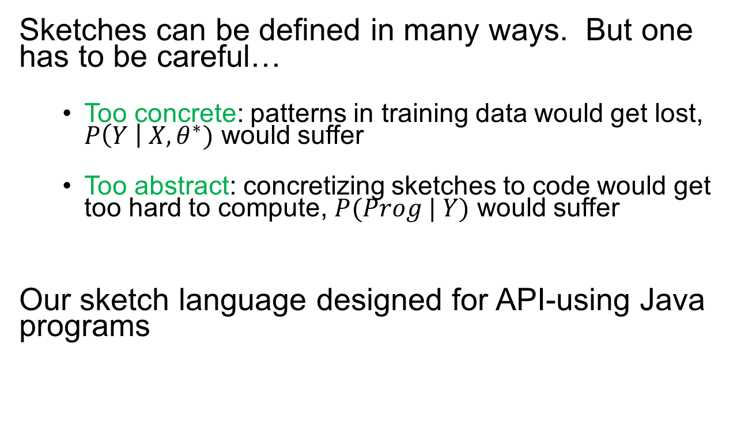
3. Sketches
Sketches can be defined in many ways. But one has to be careful…
Too concrete: patterns in training data would get lost, $P\left(Y \right| X, θ^{∗})$ would suffer
Too abstract: concretizing sketches to code would get too hard to compute, $P(Prog | Y)$ would suffer
Our sketch language designed for API-using Java programs

Slide 35
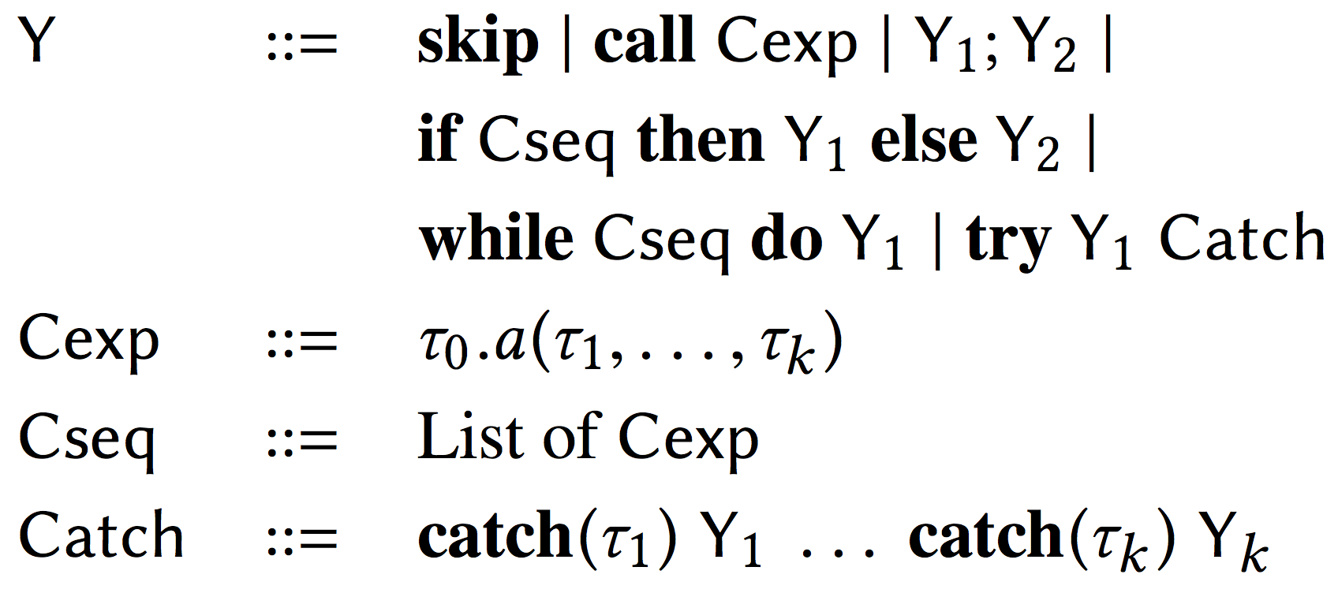
3. Sketches
Abstract API call
Type
API call

Slide 36
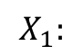
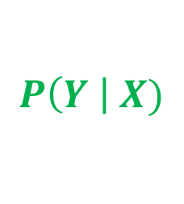
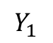
Corpus
of Programs
Feature extractor
Evidences
Sketches
Synthesized
Program
foo(File f) {
f.read();
f.close();
}
Draft Program with
Evidences
foo(File f) {
/// read file
}
Combinatorial Search
Type-based pruning
$$Y_{1}$$
Inference
$$X_{1}:$$
“read”
“file”
Distribution over
Evidences & Sketches
Evidences & Sketches
from corpus
Training
$$P\left(Y \right| X)$$
Statistical Learning
(Deep Neural Network)

Slide 37
Outline
Introduction to the Bayou framework
BayouSynth
Underlying probabilistic model
BayouDebug
Implementing BayouSynth with deep neural networks
Feed-forward Neural Network
Recurrent Neural Network
The Encoder-Decoder architecture
Gaussian Encoder-Decoder
Type-directed synthesis
Implementing BayouDebug
Latent Dirichlet Allocation and Topic-Conditioned RNN
Conclusion

Slide 38
Data-driven Correctness Analysis
Underlying thesis: Bugs are anomalous behaviors. [Engler et al., 2002; Hangal & Lam, 2002]
A specification is a commonplace pattern in program behaviors seen in the real world.
Learn specifications from examples of program behavior. [Ammons et al., 2002; Raychev et al., 2014]

Slide 39
BayouDebug
Statistical framework for simultaneously learning a wide range of specifications from a large, heterogeneous corpus
Quantitatively estimating a program’s “anomalousness” as a measure of its correctness
BayouDebug: a system for finding API usage errors in Java/Android code
Underlying probabilistic model similar to BayouSynth but “mirrored”
Program is given, need to predict likelihood of its behaviors

Slide 40
BayouDebug
Originally called Salento
Source: github.com/capergroup/salento
Bayesian Specification Learning for Finding API Usage Errors
Vijayaraghavan Murali, Swarat Chaudhuri, and Chris Jermaine.
Foundations of Software Engineering [FSE] 2017
https://arxiv.org/abs/1703.01370

Slide 41
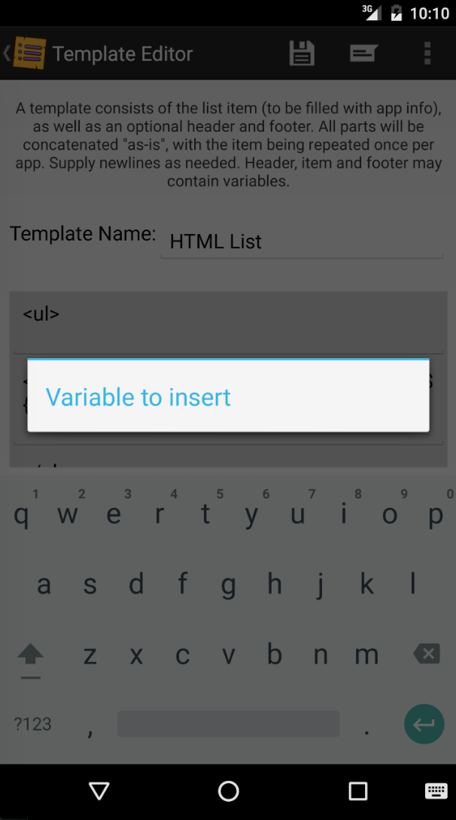
BayouDebug
AlertDialog.Builder b =
new AlertDialog.Builder(this);
b.setTitle(R.string.title_variable_to_insert);
if (focus.getId() == R.id.tmpl_item) {
b.setItems(R.array.templatebodyvars, this);
}
else if (focus.getId() == R.id.tmpl_footer) {
b.setItems(R.array.templateheaderfootervars,
this);
}
b.show();
This dialog box cannot be closed

Slide 42
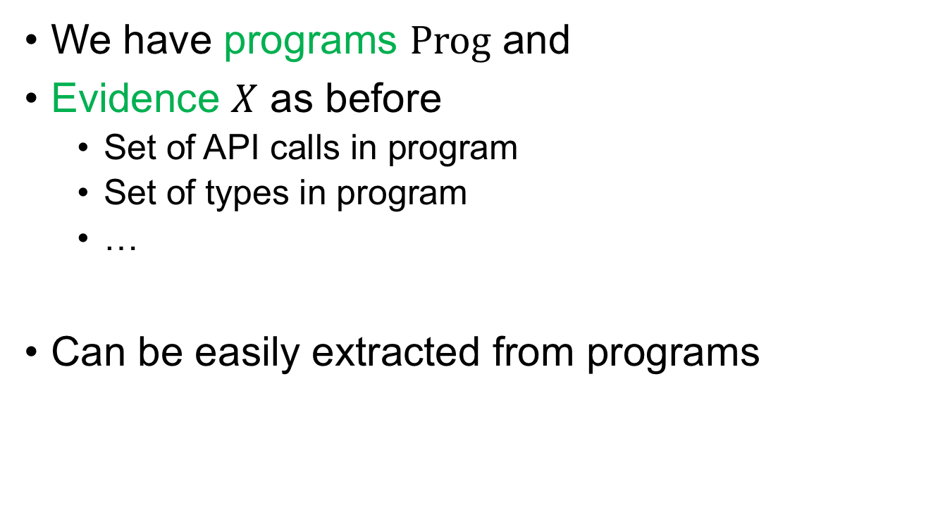
1. Evidence
$$X$$
$$\text{Prog}$$
We have programs $Prog$ and
Evidence $X$ as before
Set of API calls in program
Set of types in program
…
Can be easily extracted from programs

Slide 43
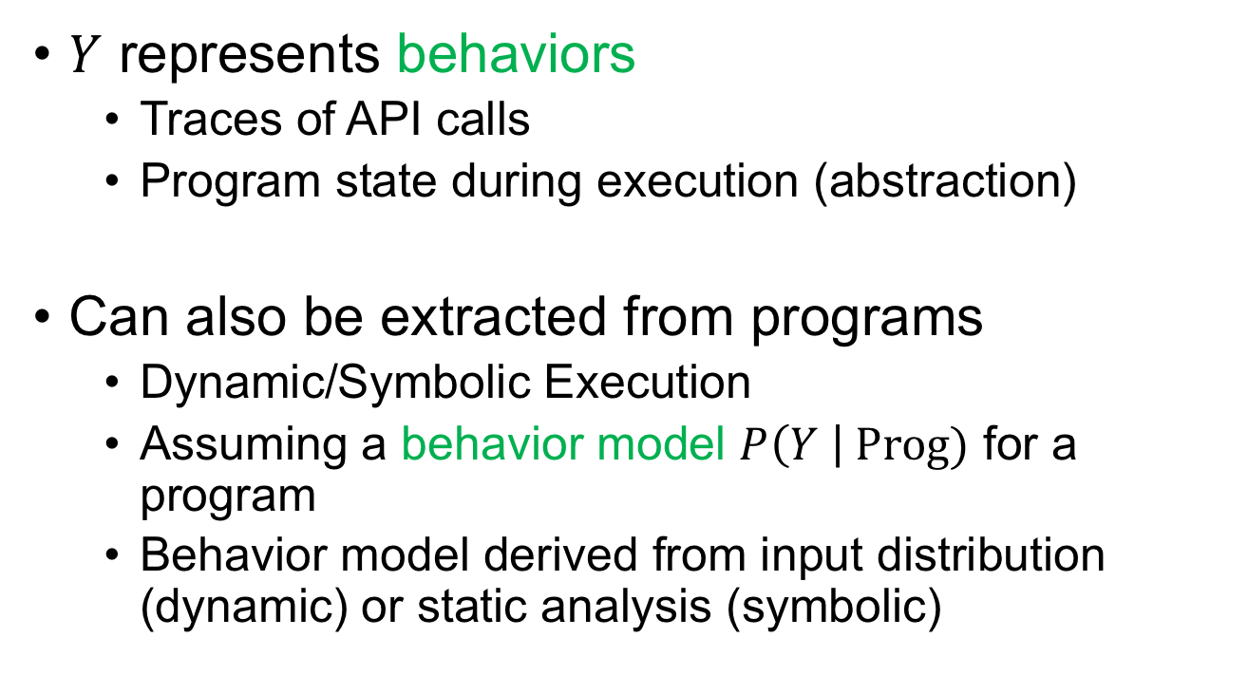

2. Behaviors
$$X$$
$$Y$$
$$Prog$$
$Y$ represents behaviors
Traces of API calls
Program state during execution (abstraction)
Can also be extracted from programs
Dynamic/Symbolic Execution
Assuming a behavior model $P\left(Y \right| Prog)$ for a program
Behavior model derived from input distribution (dynamic) or static analysis (symbolic)

Slide 44

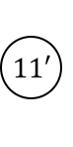
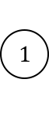
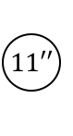
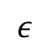
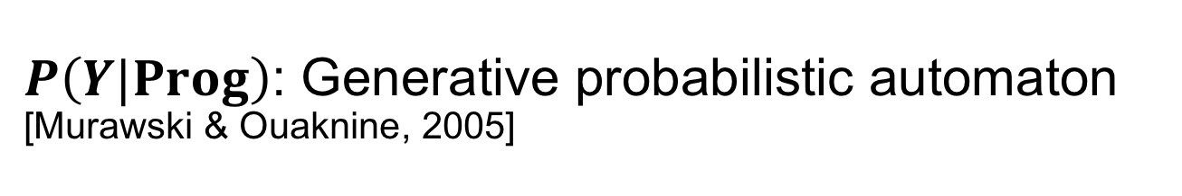
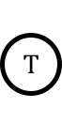
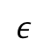
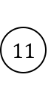
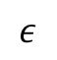
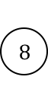
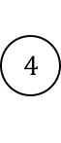


$P\left(Y|Prog\right)$: Generative probabilistic automaton [Murawski & Ouaknine, 2005]
AlertDialog.Builder b = new AlertDialog.Builder(…);
b.setTitle(…);
if (…) {
b.setItems (…);
}
else if (…) {
b.setItems(…);
}
b.show();
$$1$$
new A(…)
setTitle(…)
1.0
$$ε$$
$$ε$$
$$5$$
$$4$$
$$8$$
0.33
0.33
setItems(…)
1.0
$$ε$$
0.33
1.0
setItems(…)
$$11$$
$$11′$$
$$11′′$$
show()
1.0
1.0
show()
1.0
show()
$$T$$
$$T′$$
$$T′′$$
Produced using static analysis

Slide 45
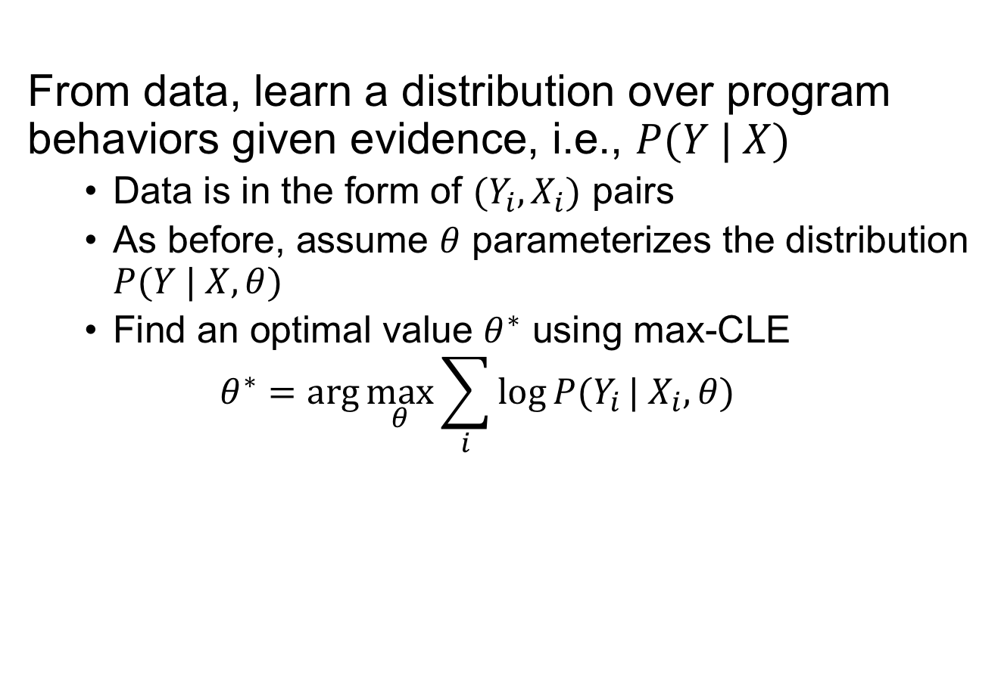
Specification Learning
$$X$$
$$Y$$
$$Prog$$
From data, learn a distribution over program behaviors given evidence, i.e., $P(Y | X)$
Data is in the form of $(Y_{i}, X_{i})$ pairs
As before, assume $θ$ parameterizes the distribution $P(Y | X, θ)$
Find an optimal value $θ^{∗}$ using max-CLE
$$θ^{∗}=\arg{\max_{θ}{\sum_{i}{\log{P(Y_{i}}| X_{i}, θ)}}}$$

Slide 46
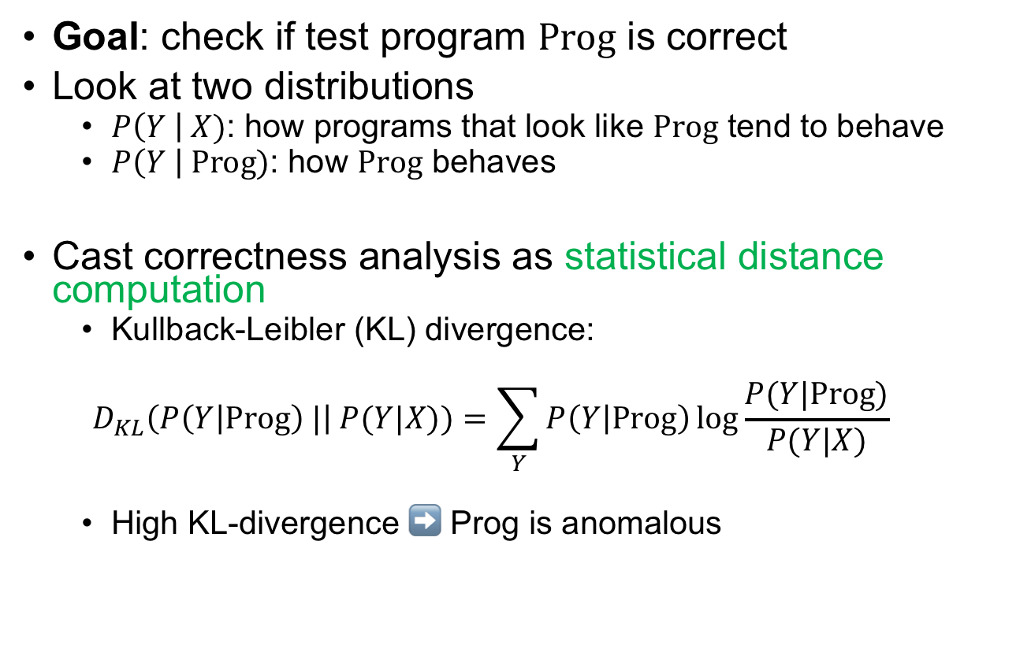
Correctness Analysis
$$X$$
$$Y$$
$$Prog$$
Goal: check if test program $Prog$ is correct
Look at two distributions
$P\left(Y \right| X)$: how programs that look like $Prog$ tend to behave
$P\left(Y \right| Prog)$: how $Prog$ behaves
Cast correctness analysis as statistical distance computation
Kullback-Leibler (KL) divergence:
$$D_{KL}\left(P\left(Y | Prog\right) |\right| P(Y|X))=\sum_{Y}{P\left(Y | Prog\right)\log{\frac{P(Y|Prog)}{P(Y|X)}}}$$
High KL-divergence ➡ Prog is anomalous

Slide 47
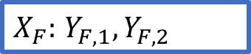
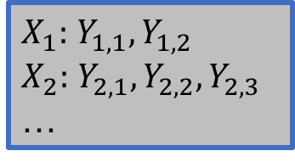
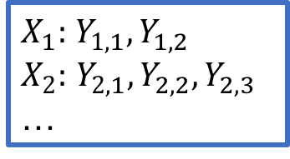
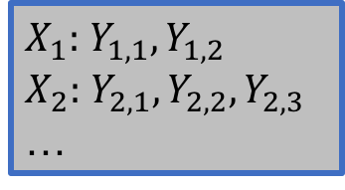
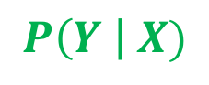
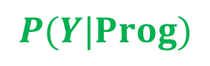
Corpus
of Programs
Feature extractor
API calls
Behaviors
Test Program F
Features & Behaviors
of test program
foo(File f) {
f.read();
f.close();
}
$X_{F}:$ $Y_{F,1},Y_{F,2}$
Inference
$X_{1}:$ $Y_{1,1},Y_{1,2}$
$X_{2}:$ $Y_{2,1},Y_{2,2},Y_{2,3}$
…
$$P(Y|Prog)$$
$X_{1}:$ $Y_{1,1},Y_{1,2}$
$X_{2}:$ $Y_{2,1},Y_{2,2},Y_{2,3}$
…
$X_{1}:$ $Y_{1,1},Y_{1,2}$
$X_{2}:$ $Y_{2,1},Y_{2,2},Y_{2,3}$
…
Distribution over
Features & Behaviors
Features & Behaviors
from corpus
$$P\left(Y \right| X)$$
Training
Statistical Learning
(Deep Neural Network)
Anomaly Score
(Aggregate)

Slide 48
What we have covered
Formal methods have always relied on formal specifications
Uncertainty in specifications is an important consideration
ML models learned from Big Code are a new and hot way of dealing with uncertainty
PL ideas are still key
Syntactic abstractions are necessary for data-driven synthesis
Static/Dynamic analysis is necessary for data-driven debugging
How to implement all of this? Coming up next…

Slide 49
Outline
Introduction to the Bayou framework
BayouSynth
Underlying probabilistic model
BayouDebug
Implementing BayouSynth with deep neural networks
Feed-forward Neural Network
Recurrent Neural Network
The Encoder-Decoder architecture
Gaussian Encoder-Decoder
Type-directed synthesis
Implementing BayouDebug
Latent Dirichlet Allocation and Topic-Conditioned RNN
Conclusion

Slide 50





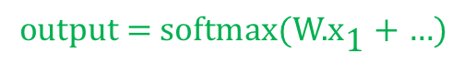
What is a Neural Network?
A logical circuit transforms binary input signals into binary outputs through logical operations
A neural network is a circuit where
Input and outputs can be smooth (continuous)
Operations are differentiable (matrix multiply, exponentiate, …)
$$\text{output}\text{ = }\text{softmax}\text{(}\text{W}\text{.}{\text{x}}_{\text{1}}\text{ + …)}$$
Embedding
$${ W}_{1}$$
$${ W}_{2}$$
$$\text{softmax}$$
$${ W}_{3}$$
$${ W}_{4}$$

Slide 51
Code Snippets
Most common machine learning libraries
We will use Tensorflow in this talk
Build a computation graph of neural network in Python
Statically compile graph into C++/CUDA
Setup training data for each input/output variable
Execute graph with data
[Abadi et al. 2016]
import tensorflow as tf

Slide 52
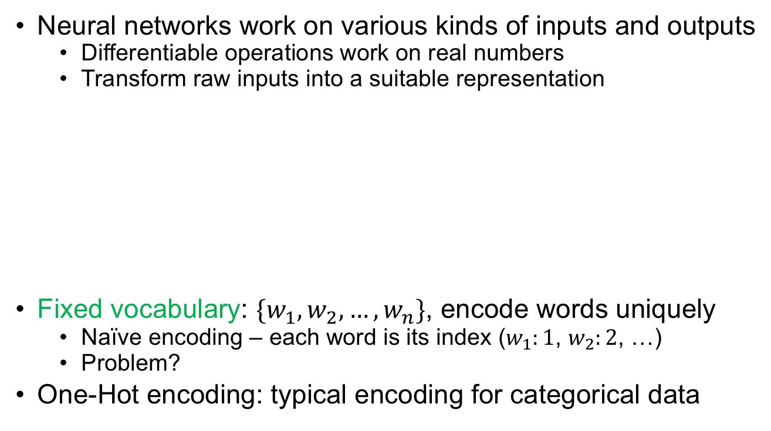
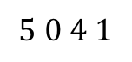
Encodings
Neural networks work on various kinds of inputs and outputs
Differentiable operations work on real numbers
Transform raw inputs into a suitable representation
Fixed vocabulary: $\{w_{1},w_{2},…,w_{n}\}$, encode words uniquely
Naïve encoding – each word is its index ($w_{1}:1$, $w_{2}:2$, …)
Problem?
One-Hot encoding: typical encoding for categorical data
I am a student
Je suis un étudiant
$$5 0 4 1$$

Slide 53
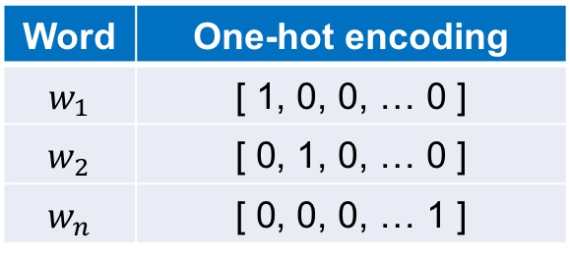

One-Hot Encoding
One-hot encoding of $w_{i}$ is an $n$-length vector where all elements are 0 except a 1 at index $i$
Pros/Cons
Easy to encode, no unintended relationships between words
Length of encoding affected by vocabulary size, infrequent words
All input evidences are assumed to have been converted to their one-hot representations
Word | One-hot encoding
$$w_{1}$$ | [ 1, 0, 0, … 0 ]
$$w_{2}$$ | [ 0, 1, 0, … 0 ]
$$w_{n}$$ | [ 0, 0, 0, … 1 ]

Slide 54








Feed-Forward Neural Network
A simple architecture of a “cell” (Tensorflow term)
Signal flows from input $x$ to output $y$
Real-valued weight and bias matrices $\text{W}$ and $\text{b}$
$$y=σ(\text{W}.x+\text{b})$$
where $σ$ is an “activation function”
$$\text{W}$$
$$\text{b}$$
$$x$$
$$\text{ ∗}$$
$$\text{ +}$$
$$σ$$
$$y$$

Slide 55

Activation Functions
Non-linear functions that decide the output format of cell
Sigmoid, output between 0 and 1: $\frac{e^{v}}{1+e^{v}}$
$tanh$, output between -1 and 1
Rectified Linear Unit (ReLU), output between 0 and $v$

Slide 56








Implementing a FFNN
$$y=σ(\text{W}.x+\text{b})$$
$$\text{W}$$
$$\text{b}$$
$$x$$
$$\text{ ∗}$$
$$\text{ +}$$
$$σ$$
$$y$$
# input_size: size of input vocabulary
# output_size: size of output as needed
x = tf.placeholder(tf.int32, [1, input_size])
W = tf.get_variable(‘W’, [input_size, output_size])
b = tf.get_variable(‘b’, [output_size])
y = tf.sigmoid(tf.add(tf.multiply(W, x), b))

Slide 57

Hidden Layers
Notion of “internal state” can be implemented through hidden layers
$$h=σ\left({\text{W}}_{h}.x+{\text{b}}_{h}\right)$$
$$y=σ(\text{W}.h+\text{b})$$
# num_units: number of units in the hidden layer
...
W_h = tf.get_variable(‘W_h’, [input_size, num_units])
b_h = tf.get_variable(‘b_h’, [num_units])
h = tf.sigmoid(tf.add(tf.multiply(W_h, x), b_h))
W = tf.get_variable(‘W’, [num_units, output_size])
b = tf.get_variable(‘b’, [output_size])
y = tf.sigmoid(tf.add(tf.multiply(W, h), b))

Slide 58















Stacking hidden layers
Forms the “deep” in deep learning
$$h_{1}=σ\left({\text{W}}_{1}.x+{\text{b}}_{1}\right)$$
$h_{2}=σ\left({\text{W}}_{2}.h_{1}+{\text{b}}_{2}\right)$ $…$
$$y=σ(\text{W}.h_{k}+\text{b})$$
Weights/biases can be shared (all ${\text{W}}_{i}$ and ${\text{b}}_{j}$ are the same)
Design choice that leads to different architectures
$$h_{1}$$
$$h_{2}$$
$${ \text{W}}_{1}$$
$${ \text{b}}_{1}$$
$${ \text{W}}_{2}$$
$${ \text{b}}_{2}$$
$$x$$
$$\text{ ∗}$$
$$\text{ +}$$
$$σ$$
$$\text{ ∗}$$
$$\text{ +}$$
$$σ$$
…
$$y$$

Slide 59
Outline
Introduction to the Bayou framework
BayouSynth
Underlying probabilistic model
BayouDebug
Implementing BayouSynth with deep neural networks
Feed-forward Neural Network
Recurrent Neural Network
The Encoder-Decoder architecture
Gaussian Encoder-Decoder
Type-directed synthesis
Implementing BayouDebug
Latent Dirichlet Allocation and Topic-Conditioned RNN
Conclusion

Slide 60














Recurrent Neural Network
RNNs model sequences of things
Assume input $x=x_{1}x_{2}…x_{n}$ and output $y=y_{1}y_{2}…y_{n}$
RNNs have a notion of hidden state across “time steps”
Feedback loop updates hidden state at each step
$$y_{t}$$
$$y_{1}$$
$$y_{2}$$
$$y_{n}$$
$h_{t}$
=
$h_{0}$
$h_{1}$
$h_{2}$
…
$h_{n}$
$${ x}_{t}$$
$${ x}_{1}$$
$${ x}_{2}$$
$${ x}_{n}$$

Slide 61

Recurrent Neural Network
Model hidden state $h_{t}$ at time step $t$ as a function of input $x_{t}$ and hidden state $h_{t−1}$
$$h_{t}=σ\left(W_{h}.x_{t}+U_{h}.h_{t−1}+b_{h}\right)$$
$$y_{t}=σ\left(W_{y}.h_{t}+b_{y}\right)$$
Each hidden state encodes entire history (as permissible by memory) due to feedback loop
Important property: weights for hidden state ($W_{h}$, $U_{h}$, $b_{h}$) are shared across time steps
Most often we do not know the number of time steps a priori
Shared weights model the same function being applied at each time step
Keeps model parameters tractable and mitigates overfitting

Slide 62
Implementing an RNN
Tensorflow provides an API for RNN cells
Configure type of RNN cell (vanilla, LSTM, etc.)
Configure activation functions (sigmoid, tanh, etc.)
# input: x = [x_1, x_2, ..., x_n]
# expected output: y_ = [y_1, y_2, ..., y_n]
# num_units: number of units in the hidden layer
rnn = tf.nn.rnn_cell.BasicRNNCell(num_units,
activation=tf.sigmoid)
state = tf.zeros([1, rnn.state_size])
y = []
for i in range(len(x)):
output, new_state = rnn(x[i], state)
state = new_state
logits = tf.add(tf.multiply(W_y, output), b_y)
y.append(logits)

Slide 63

RNNs for Program Synthesis
Consider a program as a sequence of tokens from a vocabulary of tokens
As data is noisy, we typically want to learn a distribution over programs
Output programs can be sampled from learned distribution
For a program $\text{Prog} =y_{1}y_{2}…y_{n}$ where each $y_{i}$ is a token, ${P\left(Prog\right)=P(y}_{1}).P\left(y_{2} \right|{ y}_{1}).P\left(y_{3} \right| y_{1}y_{2}) …$
Each token is obtained from a history of tokens
RNN hidden state is capable of handling history
void read() throws IOException
{
...
}
void, read, LPAREN, RPAREN, throws …

Slide 64











RNNs for Program Synthesis
If we train an RNN to learn $P\left(y_{t} \right|{ y}_{1}..y_{t−1})$ we can use it to generate code token-by-token
Synthesis strategy: sample token at time step $t$ and provide it back as input for time $t+1$
No evidence: Unconditional program generation
No sketches: Learning would be difficult
Not optimal, still useful to introduce ML concepts
$$y_{1}$$
$$y_{2}$$
$$y_{n}$$
$h_{0}$
$h_{1}$
$h_{2}$
…
$h_{n}$
$${ x}_{1}$$
$${ x}_{2}$$
$${ x}_{n}$$

Slide 65

Output Distributions
First, we need the RNN output to be a distribution
Softmax activation function
Converts a $k$-sized vector of real quantities into a categorical distribution over $k$ classes
$$softmax\left(y_{j}\right)=\frac{e^{y_{j}}}{\sum_{k}{e^{y_{k}}}}$$
Advantages over standard normalization
Handles positive and negative values
Implies raw values are in log-space, which is common in MLE
for i in range(len(x)):
output, new_state = rnn(x[i], state)
state = new_state
logits = tf.add(tf.multiply(W_y,
output), b_y)
y.append(tf.nn.softmax(logits))

Slide 66

Loss Functions
The RNN we have built would likely not produce expected outputs immediately
For training, define what it means for a model to be bad and reduce it
Loss Functions define how bad a model is with respect to expected outputs in training data
Cross-entropy (categorical)
Mean-squared error (real-valued)
Cross-entropy measures the distance between two distributions
$$H_{p}\left(q\right)=−∑ q\left(y\right)\log{p(y)}$$
$q\left(y\right)$: ground truth “distribution” (one-hot encoding)
$p\left(y\right)$: predicted distribution

Slide 67

Loss Functions
Example: vocabulary size 4
Expected output is $w_{3}$: $[0 0 1 0]$, predicted distribution: $[0.1 0.1 0.5 0.3]$
Cross-entropy loss $=−\log\left(0.5\right)=0.69$
Loss for output sequence is typically the average over sequence
Tensorflow’s API has softmax and cross-entropy sequence loss built into a single call
# expected output: y_ = [y_1, y_2, ..., y_n]
...
for i in range(len(x)):
output, new_state = rnn(x[i], state)
state = new_state
logits = tf.add(tf.multiply(W_y, output), b_y)
y.append(logits)
loss = tf.contrib.seq2seq.sequence_loss(y, y_, weights=tf.ones(...))

Slide 68














Loss Functions
Tensorflow adds loss operation to computation graph
Targets
$${_y}_{1}$$
$${_y}_{2}$$
$$_y_{n}$$
$Loss=$Softmax Cross Entropy
Outputs
$$y_{1}$$
$$y_{2}$$
$$y_{n}$$
$h_{0}$
$h_{1}$
$h_{2}$
…
$h_{n}$
$${ x}_{1}$$
$${ x}_{2}$$
$${ x}_{n}$$

Slide 69
Ingredients for Training
Loss Function
High-dimensional
function measuring error
w.r.t. ground truth
Neural Network
Complex architecture to
model generation of
outputs from inputs
Training Data
Ground truth
inputs and outputs
Gradient Descent
Find the point where function value is minimal

Slide 70
Gradient Descent
Optimization algorithm to compute (local) minimum
Iteratively move parameters in the direction of negative gradient
Need for differentiable operations
A single “step” of gradient descent
given: function f(x), loss
for each parameter p of function
p_grad = 0
for each data point d in training data
g = gradient of loss w.r.t. p for d
p_grad += g
p += -p_grad * learning_rate
Millions!
☹️
How to train neural networks efficiently?

Slide 71
Stochastic Gradient Descent
Stochastic Gradient Descent (SGD) approximates GD
Considers only a single data point for each update
Takes advantage of redundancy often present in data
Requires more parameter updates, but each iteration is faster
In practice, mini-batch Gradient Descent
Use a small number of data points (10-100)
A single “step” of gradient descent
given: function f(x), loss
for each parameter p of function
p_grad = 0
for each data point d in batch
g = gradient of loss w.r.t. p for d
p_grad += g
p += -p_grad * learning_rate
Millions!
😐

Slide 72








Backpropagation
Reverse-mode automatic differentiation
“Magic sauce” of gradient descent & deep learning
Automatically compute partial derivates of every parameter in NN
During optimization, compute gradients in almost the same order of complexity as evaluating the function
$$\text{W}$$
$$\text{b}$$
Output
Target
$$x$$
$$\text{ ∗}$$
$$\text{ +}$$
$$y$$
$$L$$
$$_y$$

Slide 73






Backpropagation
Each basic operation is associated with a gradient operation
Use chain rule to compute derivative of loss w.r.t. operation
Example: $\frac{∂L}{∂W}=\frac{∂L}{∂y}\frac{∂y}{∂+}$ $\frac{∂+}{∂∗}$ $\frac{∂∗}{∂W}$
Efficient by computing and reusing intermediate partial derivates
During SGD, all parameters can be updated in one swoop
Learning rate controls amount of update
$$\text{W}$$
$$\text{b}$$
$$\frac{∂L}{∂W}$$
$$\frac{∂L}{∂b}$$
Output
Target
$$x$$
$$\text{ ∗}$$
$$\text{ +}$$
$$y$$
$$L$$
$$_y$$
$$\frac{∂+}{∂∗}$$
$$\frac{∂y}{∂+}$$
$$\frac{∂L}{∂y}$$

Slide 74
Backpropagation
For RNNs – Backpropagation Through Time (BPTT)
“Indefinite length”, unroll into multi-layer FFNNs and backprop
Problem: Due to multiplication, run into either exploding (> 1) or vanishing (< 1) gradients
In practice, Truncated BPTT – build RNN with fixed-length and backprop till length
A single “step” of gradient descent
given: function f(x), loss
grad = 0
for each data point d in batch
g = gradient of loss w.r.t. each param for d
grad += g
backprop_gradients(grad)
Millions!
🙂

Slide 75
Training in Tensorflow
Add training operation to loss function
Tensorflow automatically adds backpropagation operations
Create a Tensorflow “session” to initialize variables
Feed mini-batches for each iteration as dictionary
...
y_ = tf.placeholder(tf.int32, [batch_size, rnn_length], ...)
step = tf.train.GradientDescentOptimizer(0.5).minimize(loss)
with tf.Session() as sess:
tf.global_variables_initializer().run()
for epoch in range(50):
batches = get_mini_batches()
for (batch_x, batch_y) in batches:
sess.run(step, feed_dict={x: batch_x, y_: batch_y})

Slide 76
Example: Character-level RNN
Training an RNN on Linux source to generate code character-by-character
Token level model may be easier or difficult
Character vocabulary (ASCII) is simpler than token vocabulary
Character model could generate malformed keywords (if, while, etc.) but token model would not
Nevertheless, interesting model to consider as example
http://karpathy.github.io/2015/05/21/rnn-effectiveness

Slide 77
static void do_command(struct seq_file *m, void *v)
{
int column = 32 << (cmd[2] & 0x80);
if (state)
cmd = (int)(int_state ^ (in_8(&ch->ch_flags) & Cmd) ? 2 : 1);
else
seq = 1;
for (i = 0; i < 16; i++) {
if (k & (1 << 1))
pipe = (in_use & UMXTHREAD_UNCCA) +
((count & 0x00000000fffffff8) & 0x000000f) << 8;
if (count == 0)
sub(pid, ppc_md.kexec_handle, 0x20000000);
pipe_set_bytes(i, 0);
}
/* Free our user pages pointer to place camera if all dash */
subsystem_info = &of_changes[PAGE_SIZE];
rek_controls(offset, idx, &soffset);
/* Now we want to deliberately put it to device */
control_check_polarity(&context, val, 0);
for (i = 0; i < COUNTER; i++)
seq_puts(s, "policy ");
}

Slide 78
Outline
Introduction to the Bayou framework
BayouSynth
Underlying probabilistic model
BayouDebug
Implementing BayouSynth with deep neural networks
Feed-forward Neural Network
Recurrent Neural Network
The Encoder-Decoder architecture
Gaussian Encoder-Decoder
Type-directed synthesis
Implementing BayouDebug
Latent Dirichlet Allocation and Topic-Conditioned RNN
Conclusion

Slide 79

Conditional Generative Model
RNNs can learn to model generation of sequences of data
$P(Prog)$ where Prog is a sequence of tokens/characters
For synthesis we need a conditional generative model
Can we condition an RNN to generate sequences based on some input?
Specifically, can we make an RNN learn $P(Y | X)$?
We can then condition the generation of code $Y$on evidence $X$
Encoder-Decoder architecture
Often used in Neural Machine Translation (NMT)
Google translate

Slide 80
















Encoder-Decoder Architecture
Key insight: To learn a conditional distribution $P(Y | X)$
Use an encoder network to encode $X$ into a hidden state
Use a decoder network to generate $Y$ from the encoded state
$$h$$
$$y_{1}$$
$$y_{2}$$
$$y_{n}$$
$${ \text{W}}_{h}$$
$${ \text{b}}_{h}$$
$$X$$
…
$$\text{ ∗}$$
$$\text{ +}$$
$$σ$$
$h_{1}$
$h_{2}$
…
$h_{n}$
$$.$$
$${ y}_{1}$$
$${ y}_{n−1}$$

Slide 81
Implementing an Encoder-Decoder
Simply compute RNN initial state using the output of FFNN
# num_units,_enc,_dec: hidden state/encoder/decoder dimensionality
...
h_enc = tf.sigmoid(tf.add(tf.multiply(W_enc, x), b_enc))
# transform into hidden state dimensions
W_h = tf.get_variable(‘W_h’, [num_units_enc, num_units])
b_h = tf.get_variable(‘b_h’, [num_units])
h = tf.sigmoid(tf.add(tf.multiply(W_h, h_enc), b_h))
rnn = tf.nn.rnn_cell.BasicRNNCell(num_units_dec, ...)
h_dec = tf.sigmoid(tf.add(tf.multiply(W_dec h), b_dec))
for i in range(len(y)):
output, new_h_dec = rnn(y[i], h_dec)
h_dec = new_h_dec
...

Slide 82


Encoder-Decoder Characteristics
Encoder and decoder must be trained together
Gradients from decoder passed all the way back to encoder
Low-dimensional hidden state
Compared to encoder inputs (one-hot) and decoder outputs (softmax)
$$Y$$
Softmax
$$X$$
…
One-hot
Encoder
Decoder

Slide 83
Encoder-Decoder Characteristics
“Bottleneck” due to (1) and (2)
Encoder learns to encode inputs in the most efficient way that is useful for decoder
Hidden state acts as a regularizer – captures the essence of inputs that is necessary to produce the right outputs
Mitigates overfitting
For the synthesis problem
Encoding multiple inputs (evidence)
In sequence? Concatenate hidden states? Average?
Decoding into trees (sketches)
Representing structure using sequence?
Inferring the most likely sketch?
Is there a principled way to do this?

Slide 84
Outline
Introduction to the Bayou framework
BayouSynth
Underlying probabilistic model
BayouDebug
Implementing BayouSynth with deep neural networks
Feed-forward Neural Network
Recurrent Neural Network
The Encoder-Decoder architecture
Gaussian Encoder-Decoder
Type-directed synthesis
Implementing BayouDebug
Latent Dirichlet Allocation and Topic-Conditioned RNN
Conclusion

Slide 85




Latent Intents
$$X$$
$$Z$$
$$Y$$
Each programming task has an intent $Z$
Example (abstractly): “file reading”, “sorting”
There is a distribution over $Z$, $P(Z)$
Since we do not know anything about $Z$, it is latent
Assume a $Normal(0, I)$ prior
We have evidence about the intent: $X$
API calls, types, keywords. Example: readLine, swap
We have implementations of the intent: $Y$
Sketches – abstractions of implementation
Given $Z$, $X$ and $Y$ are conditionally independent:
$P\left(Y | X, θ\right)=\int_{Z}{P\left(Z \right| X,θ) P\left(Y \right| Z,θ) dZ}$

Slide 86


$P\left(Z \right| X)$: Intent from Evidence
How should we define $P\left(Z \right| X,θ)$?
We can have multiple evidences $X=(x_{1},x_{2}…,x_{m})$
We want each evidence to independently shift our belief on $Z$
Define a generative model of evidence from intent
$P\left(X \right| Z, θ)=\prod_{i}{Normal(f(x_{i})|Z, σ^{2}I)}$
where $f$ is the encoding function
Models the assumption that encoded value of each evidence is a sample from a Normal centered on $Z$
$P(Z) \sim Normal(0, I)$ prior
$P(f\left(X) \right| Z) \sim Normal(Z, σ^{2}I)$ with some variance $σ^{2}$ (learned)

Slide 87












$P\left(Z \right| X)$: Intent from Evidence
From Normal-Normal conjugacy:
$$P\left(Z \right| X,θ)=Normal \left(Z \right| \frac{σ^{−2}\sum_{i}{f(x_{i})}}{1+m}, \frac{1}{1+m}I)$$
$x_{7}:$ FileReader
$x_{2}:$ swap
$$z_{1}$$
$x_{1}:$ readLine
$$z_{2}$$
$$f\left(x_{1}\right)\sim N(z_{1},σ^{2}I)$$
$$f\left(x_{7}\right)\sim N(z_{1},σ^{2}I)$$
$$f\left(x_{2}\right)\sim N(z_{2},σ^{2}I)$$
$$Z\sim N(0,I)$$

Slide 88


$P\left(Z \right| X)$: Intent from Evidence
How the encoder maps evidence to latent space
(posterior)
Animation
Encoder
$$f$$
AlertDialog
BufferedReader

Slide 89


$P\left(Y \right| Z)$: Sketch from Intent
Sketch is tree-structured, RNNs work with sequences
Deconstruct sketch into set of production paths
Based on production rules in sketch grammar
Sequence of $(v, e)$ pairs where
$v$ is a node in sketch, i.e., a term in the grammar
$e∈\{sibling, child\}$, the type of edge between $v_{i}$ and $v_{i+1}$
Sibling connects terms in the RHS of the same rule (sequential composition)
Child connects a term in the LHS with the RHS of a rule (loop condition with body)

Slide 90

$P\left(Y \right| Z)$: Sketch from Intent
4 paths in sketch
(try, $c$), (FR.new(String), $s$), (BR.new(FR), $s$), (while, $c$), (BR.readLine(), $c$), (skip, $.$)
(try, $s$), (catch, $c$), (FNFException, $c$), (printStackTrace(), .)

Slide 91

$P\left(Y \right| Z)$: Sketch from Intent
Generate sketch by recursively generating productions paths
Basic step: given $Z$ and a history of fired rules, what is the distribution over the next rule?
$P\left(v_{i+1}\right| Y_{i},Z)$ where $Y_{i}=⟨\left(v_{1},e_{1}\right),…,\left(v_{i},e_{i}\right)⟩$
Distribution dependent on history and $Z$ – not context-free!
Sample a $v_{i+1}$ and recursively generate tree
Implemented using an RNN
Neural hidden state can encode history $Y_{i}$
Top-down Tree-Structured RNNs (Zhang et al, 2016)

Slide 92
$P\left(Y \right| Z)$: Sketch from Intent
Distribution on rules that can be fired at a point, given history so far.
History encoded as a real vector.
Production rule in sketch grammar
…
0.3
0.7

Slide 93

Putting it all together…
Originally, we were interested in $θ^{∗}=\arg{\max_{θ}{\sum_{i}{\log{P(Y_{i}}| X_{i}, θ)}}}$
$$\sum_{i}{\log{P(Y_{i}}| X_{i}, θ)}$$
$$=\sum_{i}{\log{\int_{Z}{P\left(Z | X_{i},θ\right)P\left(Y_{i} | Z,θ\right)dZ}}}$$
$$=\sum_{i}{\log{E_{Z\sim P(Z|X_{i},θ)}[P\left(Y_{i} | Z, θ\right)]}}$$
$$≥\sum_{i}{E_{Z\sim P(Z|X_{i}, θ)}\left[\log{P\left(Y_{i} | Z,θ\right)}\right]}$$
$$=ℒ(θ)$$
(from our probabilistic model)
(from the Monte-Carlo definition of expectation)
(from Jensen’s inequality)
(lower bound for CLE)

Slide 94




Putting it all together…
In English
$P\left(Z \right| X,θ)$ encodes evidence $X$ into distribution over $Z$
A value of $Z$ is sampled from the distribution
$P\left(Y \right| Z,θ)$ decodes $Z$ into a sketch $Y$
Problem?
$$Y$$
STOP
Sketch
$$X$$
…
Evidence
$$Z$$
Encoder
Intent
Decoder
Gradients cannot pass through stochastic operation!

Slide 95

Reparameterization
Key intuition: all Normal distributions are scaled/balanced versions of $Normal(0, I)$
Sampling from $Normal(μ, φ)$ = sampling from $Normal(0, I)$, multiplying by $φ$ and adding $μ$
Instead of $Z \sim P\left(Z \right| X)$, get sample $ε \sim Normal(0, I)$ and compute $Z=φ∗ε+μ$
Encoder produces $μ$ and $φ$ as the parameters of $P\left(Z \right| X)$
$μ=\frac{σ^{−2}\sum_{i}{f(x_{i})}}{1+m}$ $φ=\frac{1}{1+m}I$
$ε$ is an input to the network, not part of it
Gradients can flow through!
[Kingma 2014]

Slide 96





Reparameterization
$$ε$$
Sample from $Normal(0, I)$
gradients
$$Y$$
Sketch
$$X$$
$$Z$$
…
Evidence
Intent
Encoder
Decoder
Gaussian Encoder Decoder (GED)

Slide 97
What we have covered…
How to implement neural network architectures
Feedforward Neural Network
Recurrent Neural Network
How to build an Encoder-Decoder network for program synthesis
GED is suited for synthesis but it is not the only architecture that can be instantiated from the Bayou framework
How neural networks are trained
Gradient descent, backpropagation, reparameterization
Coming up next
How the PL parts interact with the ML parts in BayouSynth and BayouDebug

Slide 98

What we have not covered...
Multi-modal evidences with different modes
API calls, types, keywords, etc. may each have a different variance towards $P(Z | X)$
Getting a distribution over top-k likely sketches instead of sampling a single sketch
Beam search
Top-Down Tree-Structured LSTM network
Architecture for learning tree-structured data
Handling complex evidences such as Natural Language
One-hot encoding would blow up, need a more “dense” embedding

Slide 99
Outline
Introduction to the Bayou framework
BayouSynth
Underlying probabilistic model
BayouDebug
Implementing BayouSynth with deep neural networks
Feed-forward Neural Network
Recurrent Neural Network
The Encoder-Decoder architecture
Gaussian Encoder-Decoder
Type-directed synthesis
Implementing BayouDebug
Latent Dirichlet Allocation and Topic-Conditioned RNN
Conclusion

Slide 100



Corpus
of Programs
Feature extractor
Evidences
Sketches
Synthesized
Program
foo(File f) {
f.read();
f.close();
}
Draft Program with
Evidences
foo(File f) {
/// read file
}
Combinatorial Search
Type-based pruning
$$Y_{1}$$
Inference
$$X_{1}:$$
“read”
“file”
Distribution over
Evidences & Sketches
Evidences & Sketches
from corpus
Training
$$P\left(Y \right| X)$$
Statistical Learning
(Deep Neural Network)

Slide 101

The Problem
$$X$$
$$Y$$
$$Prog$$
Synthesize program $Prog$ from sketch $Y$ using $P\left(Prog \right| Y)$
What do we aim to guarantee?
Program is syntactically correct
Program is type-safe
Program follows language-level rules (e.g., exceptions, imports)
What is required to produce a program that can guarantee the above?

Slide 102
The Problem
Finding expressions of the right type
Declaring & initializing variables
FileReader fr;
BufferedReader br;
String s;
try {
fr = new FileReader(“a.txt”);
br = new BufferedReader(fr);
while ((s=br.readLine())!=null) {
...
}
br.close();
} catch (IOException e) {
...
}
[
call FileReader.new(String) call BufferedReader.new(FileReader) loop ([BufferedReader.readLine()]) { skip } call BufferedReader.close() ]
Synthesizing code to handle language rules
Type-directed synthesis

Slide 103

Programs from Sketches
Given an environment of variables…
Map from variable names to types
Example: $\{x\text{: }\text{String}, y\text{: }\text{Integer}\}$
and a set of functions …
Library methods associated with each type
Example, for String: $\{$ substring: Integer $→$ String, concat: String $→$ String, … $\}$
find an expression of a target type $τ$
Example, $τ=$ String: x, y.toString(), x.concat(y.toString()), x.substring(y)
Search over space of function compositions
Type-based pruning and cost-based heuristic

Slide 104


Programs from Sketches
Invocation chain: a composition of method calls
a().b().c()… or a(b(c(…))) or a mixture
Two-step enumerative search
Up to bounded breadth, gather all invocation chains
x.toString().?
toString()
Target: $τ$
x.concat(…).?
$$x$$
concat(String)
x.contains(…).?
contains(String)

Slide 105



Type-based Pruning
For each invocation chain, recursively search for expressions for arguments in the chain
During search, prune invocation chain $c$ if return type of chain $τ_{c}$ is such that $τ_{c}$ is not a subtype of $τ$
toString()
Target: CharSequence
Target: String
$$x$$
concat(String)
Recursive
Search
$$…$$
✗
contains(String)
Return type: Boolean
Not a subtype of CharSequence

Slide 106

Cost-based Heuristic
How to order the search for expressions?
No definitive answer, use a heuristic cost function
Performance: expression should be found quickly
Parsimony: expression should be simple
Relevance: expression should use user-provided variables
…
Cost function sorts a list of invocation chains or expressions according to heuristics
Implicitly controls the “distribution” $P\left(Prog \right| Y)$

Slide 107


Programs from Sketches
Given
An environment $Env$, initially user-provided
Function $search(τ, Env)$ that finds an expression of type $τ$ from environment $Env$
Let $syn(e,Env)$be the function that synthesizes a sketch expression $e$ into code in environment $Env$
Sketch expression $e$ | Code produced by $syn(e,Env)$ | Update to $Env$
call $τ_{0}.a\left(τ_{1},…,τ_{n}\right)$ | x = e₁.a(e₂, ..., e_{n}) where e_{k} = $search(τ_{k}, Env)$ | $Env := Env∪\{x:τ_{a}\}$ where $τ_{a}$ is the return type of method a
loop (cond) { body } | while ((b=$syn(\text{cond},Env)$) { $syn(\text{body},Env)$ } | $Env := Env∪\{b:\text{Boolean}\}$
… | … | …

Slide 108
Programs from Sketches
Post-processing of code
Add variable declarations from new variables in environment
Add import declarations, try-catch for unhandled exceptions, etc.
Caveats
Some sketches may not be synthesizable into programs
Environment is not sufficient to find expressions
Neural model went crazy (e.g., void method in loop condition) – experiments show extremely unlikely
Many Java APIs utilize generic types
Requires search for types before search for expressions of type
Wildcard types, bounded types, …

Slide 109

Experiments
Corpus: online repository of
1500 Android apps
100M lines of code
150K methods, randomly selected 10K methods in test set
Data: convert all Java code into canonical subset of Java without syntactic sugar
Each method is a “program”
From each method, extract evidence $X$, sketch $Y$
Implementation: Bayou
Refer to paper for hyper-parameters and training environment

Slide 110
Experiments

Slide 111


Training
Clustering of GED latent space ($Z$) after training

Slide 112
Inference
Goal 1: test accuracy of model in synthesizing programs
Problem: semantic equivalence is undecidable!
Approximately measure equivalence using
Syntactic check – decidable
Quantitative metrics – How similar are the sets/sequences of API calls, structures in code, etc.?
Goal 2: measure the effect of sketch learning on accuracy
Goal 3: how does the number of input evidences affect accuracy?
Goal 4: how does the GED compare with related models?
Goal 5: how well does it generalize to unseen data?

Slide 113
Inference
Observability: percentage of total input evidence that model was provided
GSNN: Model related to GED, Gaussian Stochastic NN [Sohn 2016]
NoSkch: model trained directly over AST of programs

Slide 114
Qualitative Evaluation
Probability: 0.08
[
call InputStreamReader.new(InputStream) call BufferedReader.new(Reader)
call BufferedReader.readLine() ]
Probability: 0.06
[ call BufferedReader.new(Reader)
call BufferedReader.readLine() ]
Probability: 0.01
[
call FileReader.new(File) call BufferedReader.new(Reader)
call BufferedReader.readLine() ]
API calls: { readLine }

Slide 115
Qualitative Evaluation
Probability: 0.04
[
call FileReader.new(File) call BufferedReader.new(Reader)
call BufferedReader.readLine() ]
Probability: 0.02
[
call FileReader.new(File) call BufferedReader.new(FileReader) loop ([BufferedReader.readLine()]) { skip } call BufferedReader.close() ]
<more results using FileReader>
API calls: { readLine }
Types: { File }
Note: did not explicitly specify FileReader

Slide 116
Conclusion
A method for generating type-safe programs in a Java-like language from uncertain inputs
Key insight: learn over sketches (abstractions) of programs, then use combinatorial methods to generate final program
Implementation — Bayou — shows promise in generating complex method bodies from a few tokens
Future work
Neural architecture for program generation from natural language
Permit instance-specific constraints during program generation using semantic information
Big Takeaway
To synthesize code:
Use machine learning to learn to generate sketches
Use formal methods to synthesize final code

Slide 117
Outline
Introduction to the Bayou framework
BayouSynth
Underlying probabilistic model
BayouDebug
Implementing BayouSynth with deep neural networks
Feed-forward Neural Network
Recurrent Neural Network
The Encoder-Decoder architecture
Gaussian Encoder-Decoder
Type-directed synthesis
Implementing BayouDebug
Latent Dirichlet Allocation and Topic-Conditioned RNN
Conclusion

Slide 118

BayouDebug: A recap
Two random variables:
$X$: Evidence (set of syntactic tokens)
$Y$: Behavior (sequence of program actions).
During training, learn a distribution $P(Y | X).$
While debugging a program $Prog$ with evidence $X$, start with a distribution $P\left(Y \right| Prog)$.
Anomaly score for Prog: compute a statistical distance
$D_{KL}\left(P\left(Y | Prog\right) |\right| P(Y|X))$.

Slide 119
Corpus
of Programs
Feature extractor
API calls
Behaviors
Test Program F
Features & Behaviors
of test program
foo(File f) {
f.read();
f.close();
}
$X_{F}:$ $Y_{F,1},Y_{F,2}$
Inference
$X_{1}:$ $Y_{1,1},Y_{1,2}$
$X_{2}:$ $Y_{2,1},Y_{2,2},Y_{2,3}$
…
$$P(Y|Prog)$$
$X_{1}:$ $Y_{1,1},Y_{1,2}$
$X_{2}:$ $Y_{2,1},Y_{2,2},Y_{2,3}$
…
$X_{1}:$ $Y_{1,1},Y_{1,2}$
$X_{2}:$ $Y_{2,1},Y_{2,2},Y_{2,3}$
…
Distribution over
Features & Behaviors
Features & Behaviors
from corpus
$$P\left(Y \right| X)$$
Training
Statistical Learning
(Deep Neural Network)
Anomaly Score
(Aggregate)

Slide 120
Implementing BayouDebug
Can be implemented using the same model as BayouSynth.
Current efforts along these lines.
Here we will show a different implementation used in the original conference paper.
Example of how the Bayou framework can be implemented in multiple ways.

Slide 121
Example: Visual Idioms
AlertDialog.Builder b =
new AlertDialog.Builder(this);
b.setTitle(R.string.title_variable_to_insert);
if (focus.getId() == R.id.tmpl_item) {
b.setItems(R.array.templatebodyvars, this);
}
else if (focus.getId() == R.id.tmpl_footer) {
b.setItems(R.array.templateheaderfootervars,
this);
}
b.show();
This dialog box cannot be closed

Slide 122
$P\left(Y|Prog\right)$: Generative probabilistic automaton [Murawski & Ouaknine, 2005]
AlertDialog.Builder b = new AlertDialog.Builder(…);
b.setTitle(…);
if (…) {
b.setItems (…);
}
else if (…) {
b.setItems(…);
}
b.show();
$$1$$
new A(…)
setTitle(…)
1.0
$$ε$$
$$ε$$
$$5$$
$$4$$
$$8$$
0.33
0.33
setItems(…)
1.0
$$ε$$
0.33
1.0
setItems(…)
$$11$$
$$11′$$
$$11′′$$
show()
1.0
1.0
show()
1.0
show()
$$T$$
$$T′$$
$$T′′$$
Produced using static analysis

Slide 123
Statistical model
Introduce a latent variable $Z.$
Represents a program’s true specification.
Controls syntactic features X as well as behaviors Y.
Distribution captures frequency of different “types” of programs
GUI programs, low-level system programs, scientific programs,…
Assumption: X and Y conditionally independent given Z.
$$Z$$
$$X$$
$$Y$$

Slide 124
Statistical Model
$$P(Y | X) =∫P(Y | Z) P(Z | X) dZ$$
Z represented as a real vector.
$P\left(Z | X\right)$ obtained from a topic model called Latent Dirichlet Allocation (LDA) [Blei, Ng, and Jordan, 2003]
$P\left(Y | Z\right)$ given by a topic-conditioned recurrent neural network [Mikolov and Zweig, 2012]

Slide 125
Latent Dirichlet Allocation (LDA)
Generative topic model, widely used in NLP
Models a bag of symbols as a distribution over topics
A bag can be 50% ‘dog-related’, 30% ‘cat-related’, 20% ‘other’
Models a topic as a distribution over symbols
‘dog-related’ generates “woof” and “bark” with high probability
Notes:
500 packages
Compute posteriors using Gibbs sampling

Slide 126
For us…
Symbols are API calls.
A specification $Z$ is a topic distribution!
Topics represent different APIs, or distinct ways of using the same API.
A specification is a way of mixing different styles.
Algorithmically:
Training process learns a full joint distribution P(X, Z).
During inference, use a sampling technique, for example Gibbs sampling, to estimate P(Z | X).
Notes:
500 packages

Slide 127
A.setMessage(int) A.setTitle(int) new A(Context) A.setPositiveButton(int,…) A.show()
A.setView(View) new A(Context) A.setTitle(CharSequence) A.setPositiveButton(int,…) A.setTitle(int)
A.setPositiveButton(CharSequence,…) A.setNegativeButton(CharSequence,…) A.setMessage(CharSequence) A.setTitle(CharSequence) A.show()
C.getInstance(String) C.init(int,Key,…) C.doFinal(byte[]) B.close() C.init(int,Key)
Top 5 symbols from a few topics in an Android corpus. A is the DialogBox API. B and C are other APIs

Slide 128
Topic-conditioned recurrent neural networks
Recurrent neural networks (RNNs) model a distribution P(Y) over sequences $Y.$
A topic-conditioned RNN also takes in a topic distribution $Z$, and implements P(Y | Z).
$$y_{1}$$
$$y_{2}$$
$$y_{n}$$
$h_{0}$
$h_{1}$
$h_{2}$
…
$h_{n}$
$$z$$
$${ x}_{1}$$
$${ x}_{2}$$
$${ x}_{n}$$

Slide 129

Tying it all together
To estimate $P\left(Y \right|X):$
Sample $Z_{1}, …, Z_{m} \sim P\left(Z \right|X)$using Gibbs sampling.
For each $Z_{i}$, sample $Y_{i1},…,Y_{ik}$using topic-conditioned RNN.
The $Y_{ij}$’s follow $P\left(Y \right|X).$

Slide 130

Anomaly detection
Goal: Compute the sum
$$D_{KL}\left(P\left(Y | Prog\right) |\right| P(Y|X))=\sum_{Y}{P\left(Y | Prog\right)\log{\frac{P(Y|Prog)}{P(Y|X)}}}$$
where Y ranges over paths in an automaton.
A problem in automata analysis!
We estimate sum by sampling.

Slide 131
Back to the example…
AlertDialog.Builder b = new AlertDialog.Builder(…);
b.setTitle(…);
if (…) {
b.setItems (…);
}
else if (…) {
b.setItems(…);
}
b.show();
The model assigns the buggy path a very low probability.
Leads to a high anomaly score (3.16) for the program.
Deleting the path from the automaton reduces score to 0.01.

Slide 132
BayouDebug*
Detecting anomalous API usage in Java/Android code
Built using Tensorflow, scikit-learn, and Soot
Evaluated on a corpus of 2500 Android apps, ~180 million lines of code
* Called Salento in original paper.

Slide 133
Sample bugs
Showing dialog boxes without buttons
Using improper encryption mode
Single crypto object used to encrypt/decrypt multiple data
Closing unopened Bluetooth socket
Failed socket connection left unclosed
Dialog displayed without message
Unusual button text
…
Example behaviors of programs with top-10% anomaly scores

Slide 134
Distribution of anomaly scores

Slide 135
Precision-recall plot

Slide 136
Effect of random mutations

Slide 137
Outline
Introduction to the Bayou framework
BayouSynth
Underlying probabilistic model
BayouDebug
Implementing BayouSynth with deep neural networks
Feed-forward Neural Network
Recurrent Neural Network
The Encoder-Decoder architecture
Gaussian Encoder-Decoder
Type-directed synthesis
Implementing BayouDebug
Latent Dirichlet Allocation and Topic-Conditioned RNN
Conclusion

Slide 138
1. Uncertainty matters
Formal methods and programming systems research typically ignore uncertainty in intent and incompleteness of knowledge.
This is unfortunate, as programming is a human process.

Slide 139
2. Big Code can help
In formal methods and programming systems, one typically solves each problem from scratch.
We can do better by exploiting common idioms and specifications.
Statistical models trained on large code corpora can provide this knowledge.
Bayou uses deep models. However, in some scenarios, non-deep models with explicitly represented features might work as well or better.

Slide 140
Many models in recent work
Graphical models:
Predicting program properties from Big Code. Raychev, Vechev, and Krause. POPL 2015.
Extensions of Probabilistic grammars
Mining idioms from source code. Allamanis & Sutton. FSE 2014.
Structured generative models of natural source code. Maddison & Tarlow. ICML 2014.
Feature synthesis + probabilistic grammars:
PHOG: Probabilistic model for code. Bielik, Raychev, and Vechev. ICML 2016.
Graph neural networks:
Learning to represent graphs with programs. Allamanis, Brockschmidt, Khademi. ICLR 2018.

Slide 141
Many models in recent work
Graphical models:
Predicting program properties from Big Code. Raychev, Vechev, and Krause. POPL 2015.
Extensions of Probabilistic grammars
Mining idioms from source code. Allamanis & Sutton. FSE 2014.
Structured generative models of natural source code. Maddison & Tarlow. ICML 2014.
Feature synthesis + probabilistic grammars:
PHOG: Probabilistic model for code. Bielik, Raychev, and Vechev. ICML 2016.
Graph neural networks:
Learning to represent graphs with programs. Allamanis, Brockschmidt, Khademi. ICLR 2018.
Emerging wisdom: straightforward application of
off-the-shelf ML models can only go so far

Slide 142
3. PL matters
Programs are different from traditional ML domains:
More structured
Crisp requirements such as type safety.
PL ideas such as types, logical deduction, compositionality are critical to handling discrete program structure and enforcing guarantees.
Needed: a science of software that combines classic PL with statistical, data-driven ideas.

Slide 143
Thank You!

